Slide 2
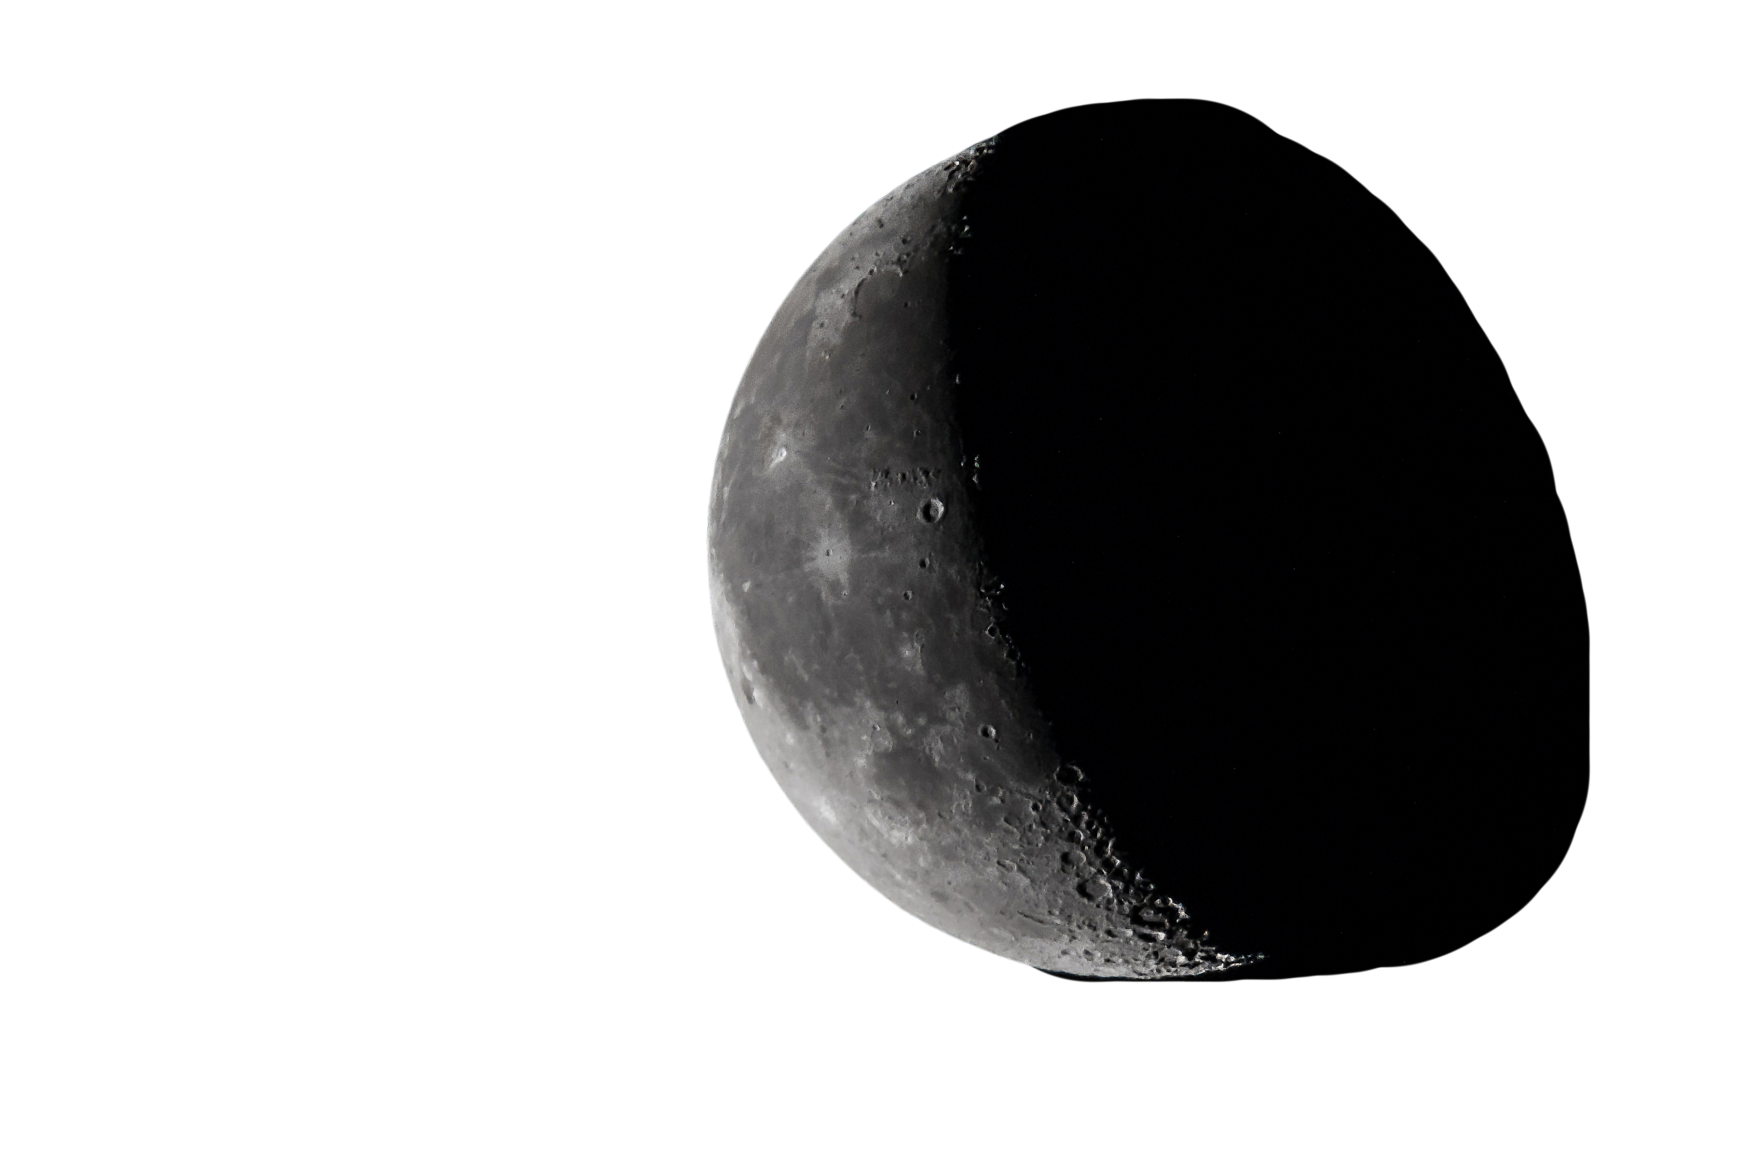




Slide 3

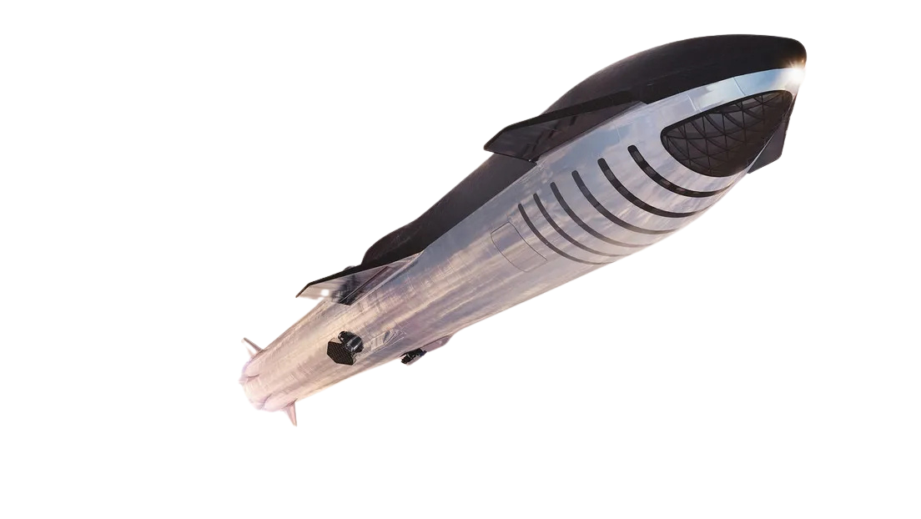
LAUNCHING
THE FUTURE
Horizon Alpha revolutionizes lunar-based launches, delivering efficient pathways to interplanetary exploration.

Slide 4


ABOUT
US
Dedicated to pioneering life on the Moon and expanding humanity’s reach to Jupiter’s moon Europa. Through our ambitious missions, we are driving innovation and creating sustainable pathways for exploration and settlement beyond Earth.

Slide 5
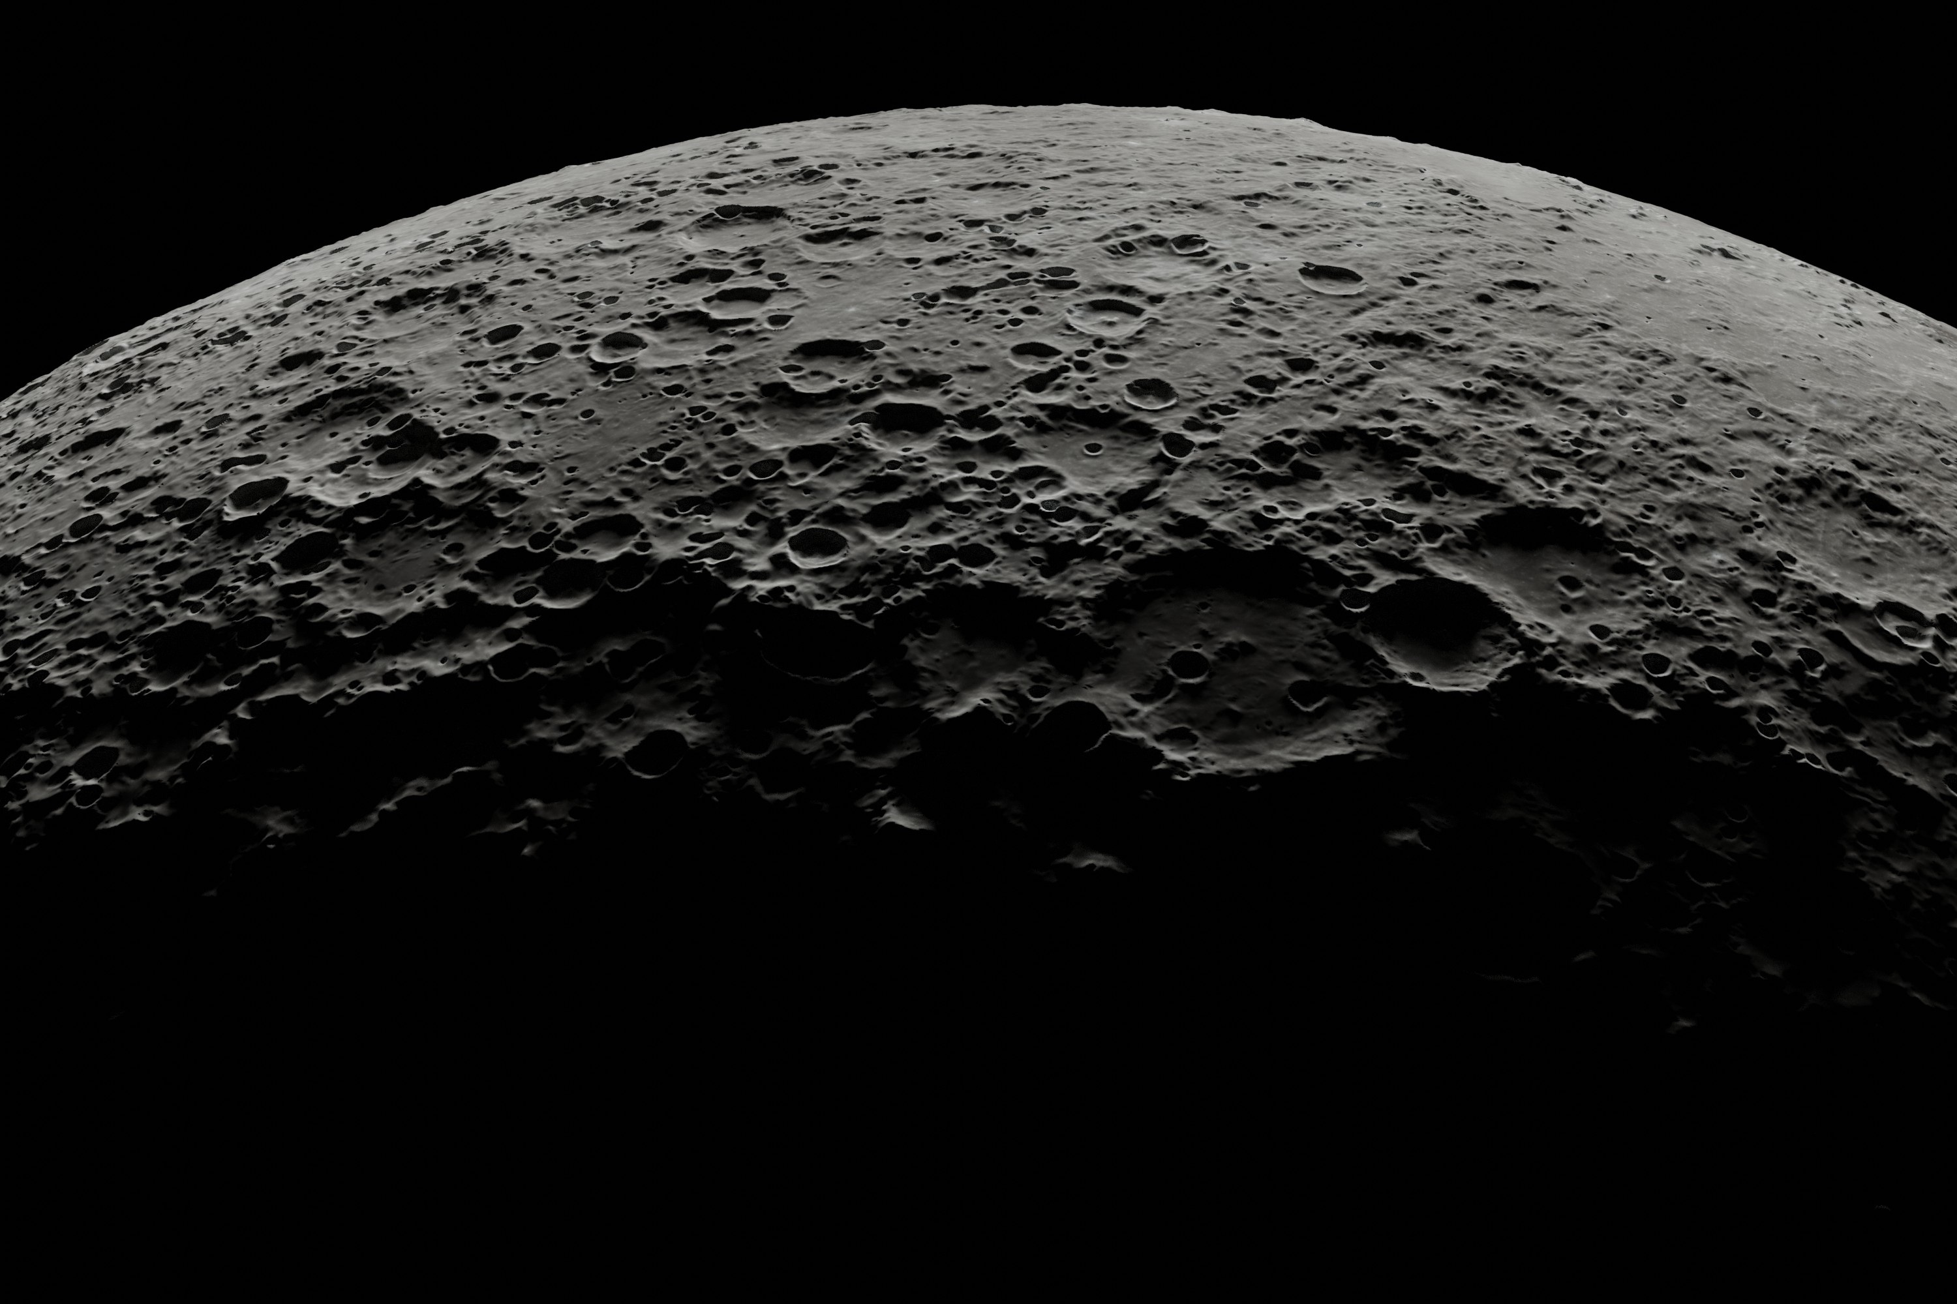


OUR
MISSIONS
VOYAGER
HORIZON
Focuses on deploying innovative technologies to build lunar habitats, develop resource extraction systems, and create a reliable transportation network between Earth and the Moon.
Leveraging the knowledge gained from Mission Voyager, Horizon will push the boundaries of deep space exploration by developing advanced spacecraft capable of traveling vast interplanetary distances.

Slide 6
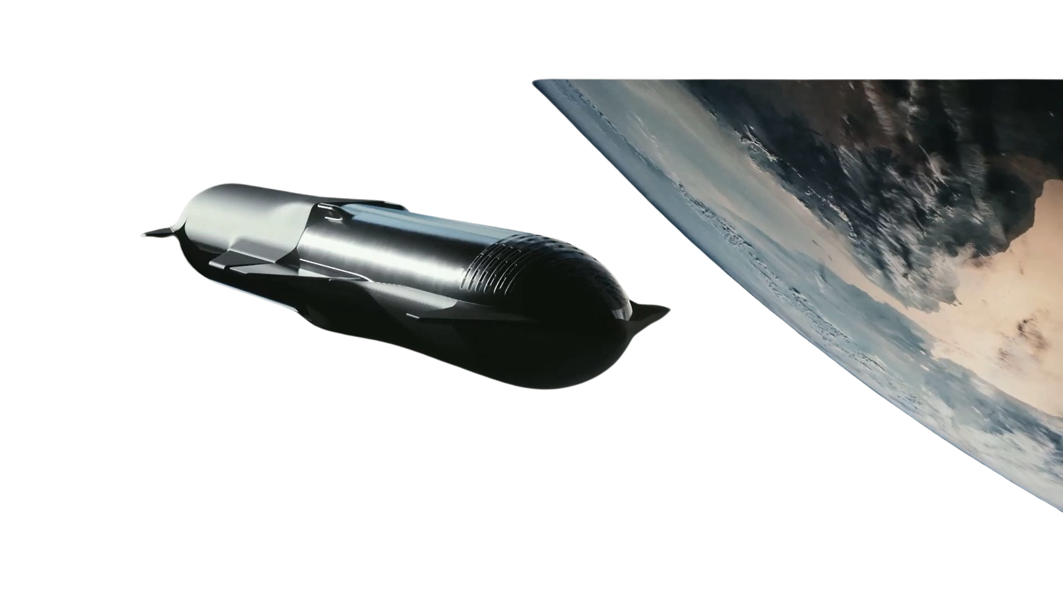
THE NEED FOR
A NEW HORIZON
Current space logistics rely solely on Earth-based launches, which are expensive and inefficient for deep-space missions.
The Moon provides a low-gravity launch site, reducing costs and enabling efficient missions to destinations like Europa.

Slide 7
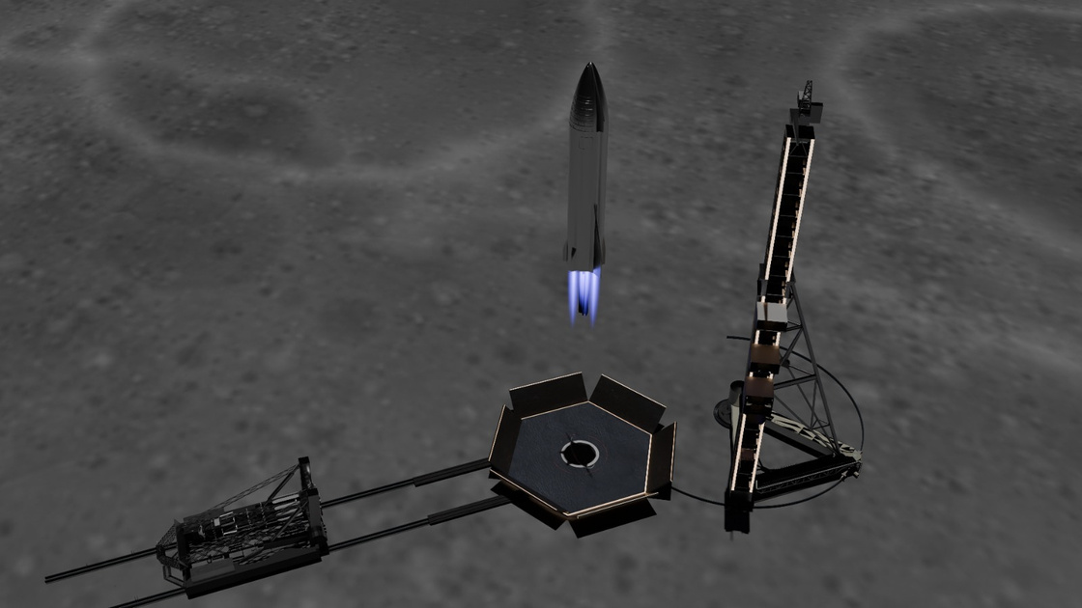
Why
Europa?
RELAUNCH
POWERED BY INNOVATION
Vision
Mission
Europa is vital for its subsurface oceans, hinting at potential life, and abundant resources for future missions.
A strategic gateway to Europa, cutting travel time and costs for deep-space missions.

Slide 8
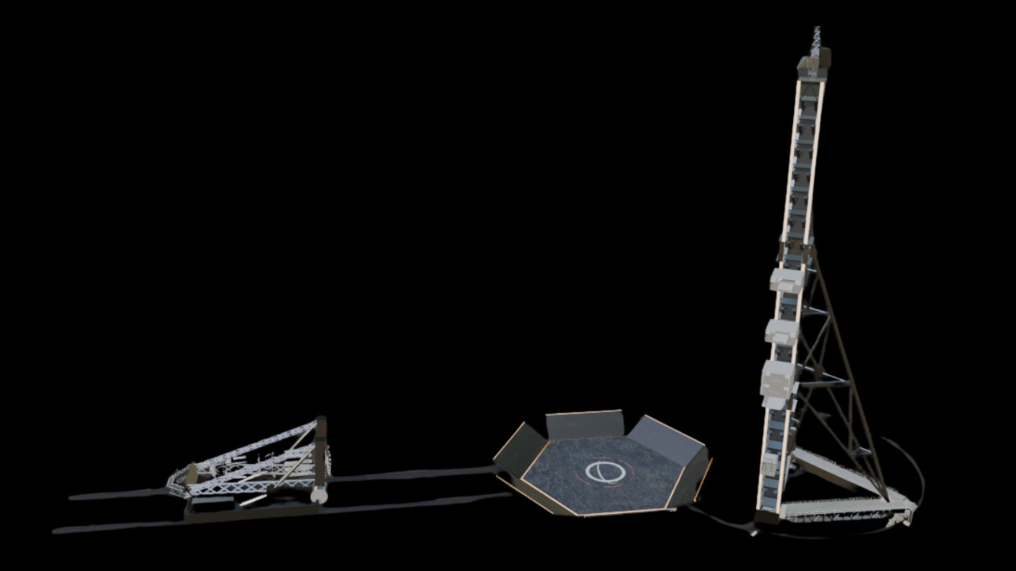
A REVOLUTIONARY
LUNAR RELAUNCH BASE
Horizon Alpha is a relaunch base on the Moon, built as part of the Horizon mission and the final stage of the Voyager program developed by MSJFA.

Slide 9
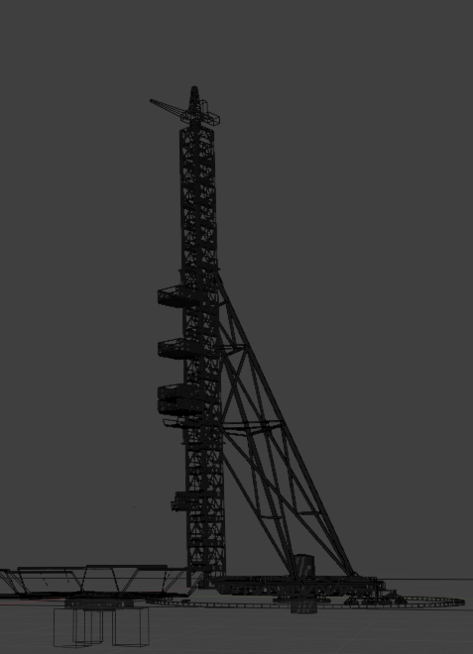
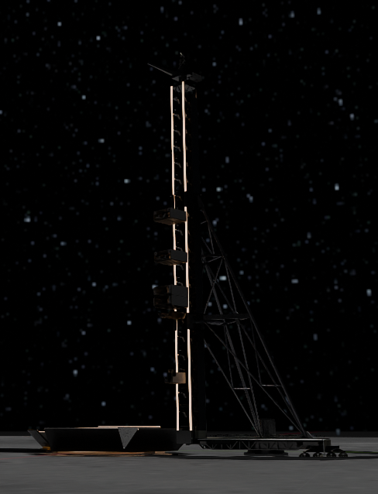
Reusable and optimized for lunar operations.
Engineered for efficiency, ensuring seamless operations on the Moon. Its modular design allows for adaptability and sustainability in challenging environments.
RELAUNCH
Designed for Starship Class rockets.
STARSHIP
Crafted to integrate with Starship class vehicles, Horizon Alpha guarantees compatibility, enhancing payload capacity and mission flexibility.
CLASS

Slide 10
STRATEGIC
ADVANTAGES
FEATURE | HORIZON ALPHA | SpaceX (Offshore) | Blue Origin
Location | Moon | Earth | Earth
Supports Starship Class Rockets | Yes | Yes | No
Reusability | Advanced | High | Limited
Sustainability | ISRU-Driven | Moderate | Moderate

Slide 11
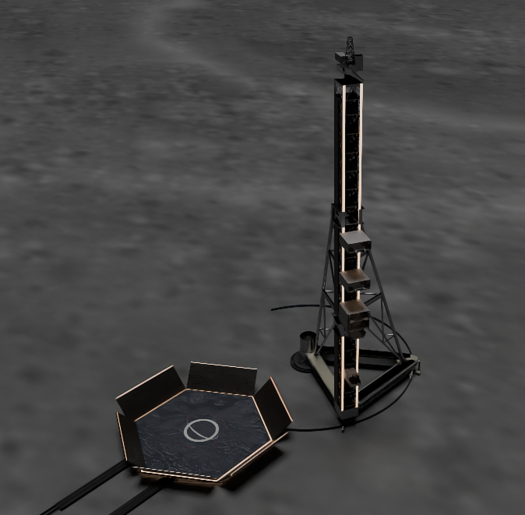

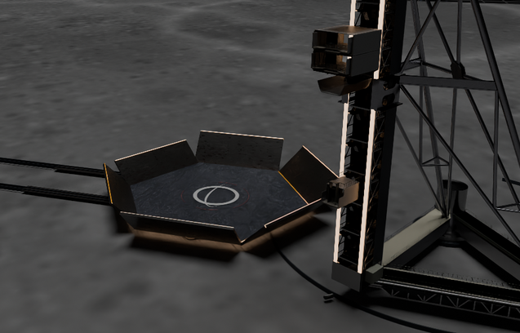
Key
FEATURES
High-strength alloys and heat-resistant ceramics ensure durability and flexibility during launch and re-entry.
A flexible tower that adjusts to different rocket sizes and provides essential infrastructure for launches.
Automated systems and specialized vehicles quickly recover and reposition rockets after landing.

Slide 12
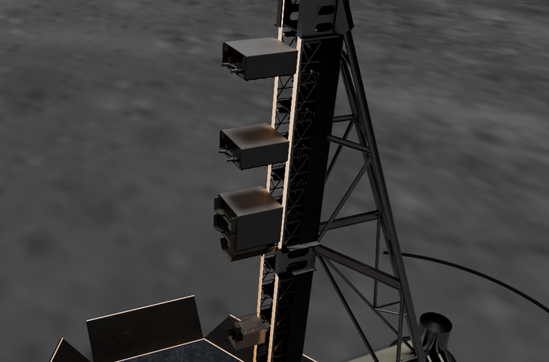
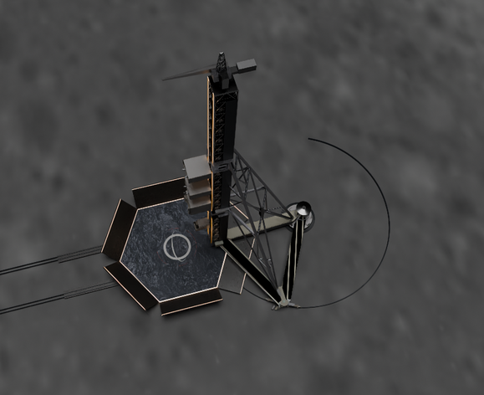
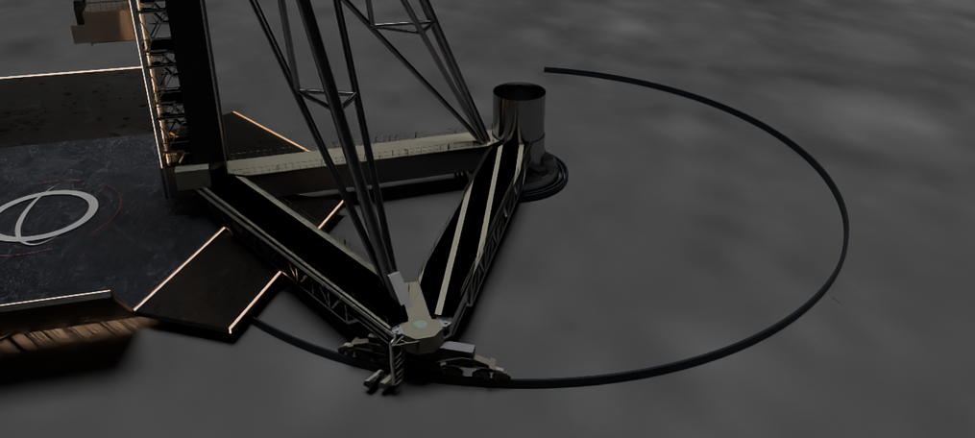
Key
FEATURES
Positioned in a carefully chosen location to facilitate rocket operations, ensuring maximum efficiency and minimizing risks.
The system supports rapid rocket turnaround, allowing Starship-class rockets to quickly be prepared for their next mission
Featuring robotic arms and a network of systems designed to quickly and effectively refuel and conduct maintenance on rockets

Slide 13

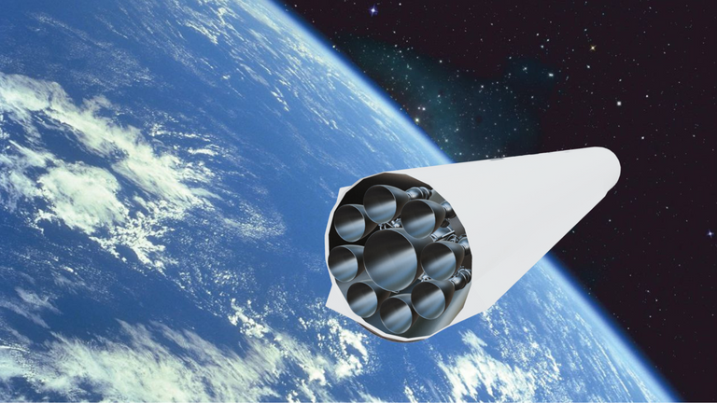
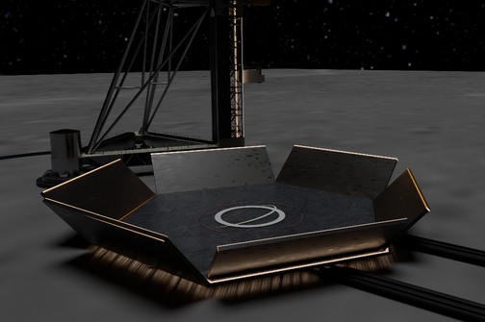
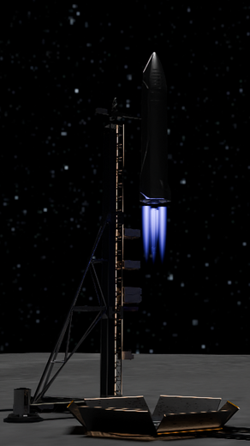
EUROPA
Transport
Assemble
Relaunch
3 PHASE
PLAN

Slide 14

OUR
NUMBERS
While Horizon Alpha requires a higher initial investment, its innovative lunar positioning enables significantly greater annual revenue, showcasing its long-term profitability and strategic advantage in space exploration.

Slide 15
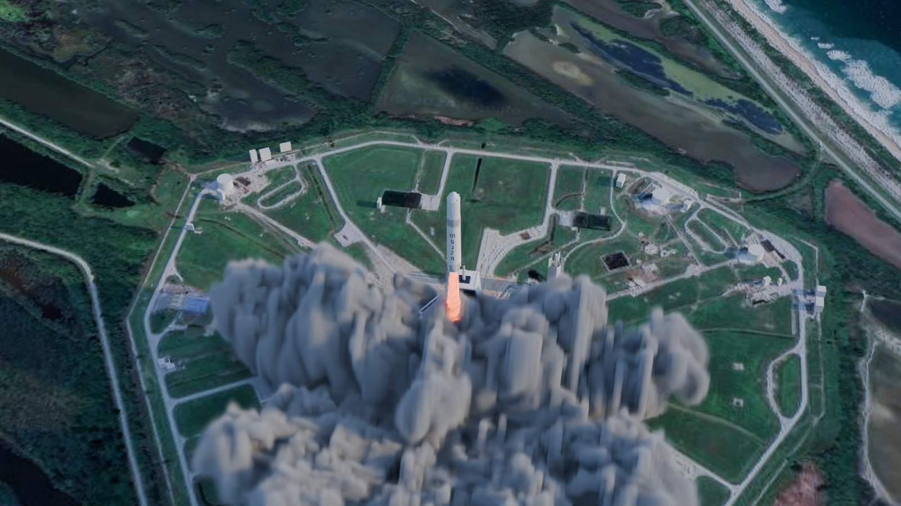


Get in Touch
SCAN ME
Email
msjfa.mexico@gmail.com
Phone Number
+52 55 32 53 38 59
Social Media
@msjfa_mexico
RELAUNCH
RELAUNCH

Slide 16

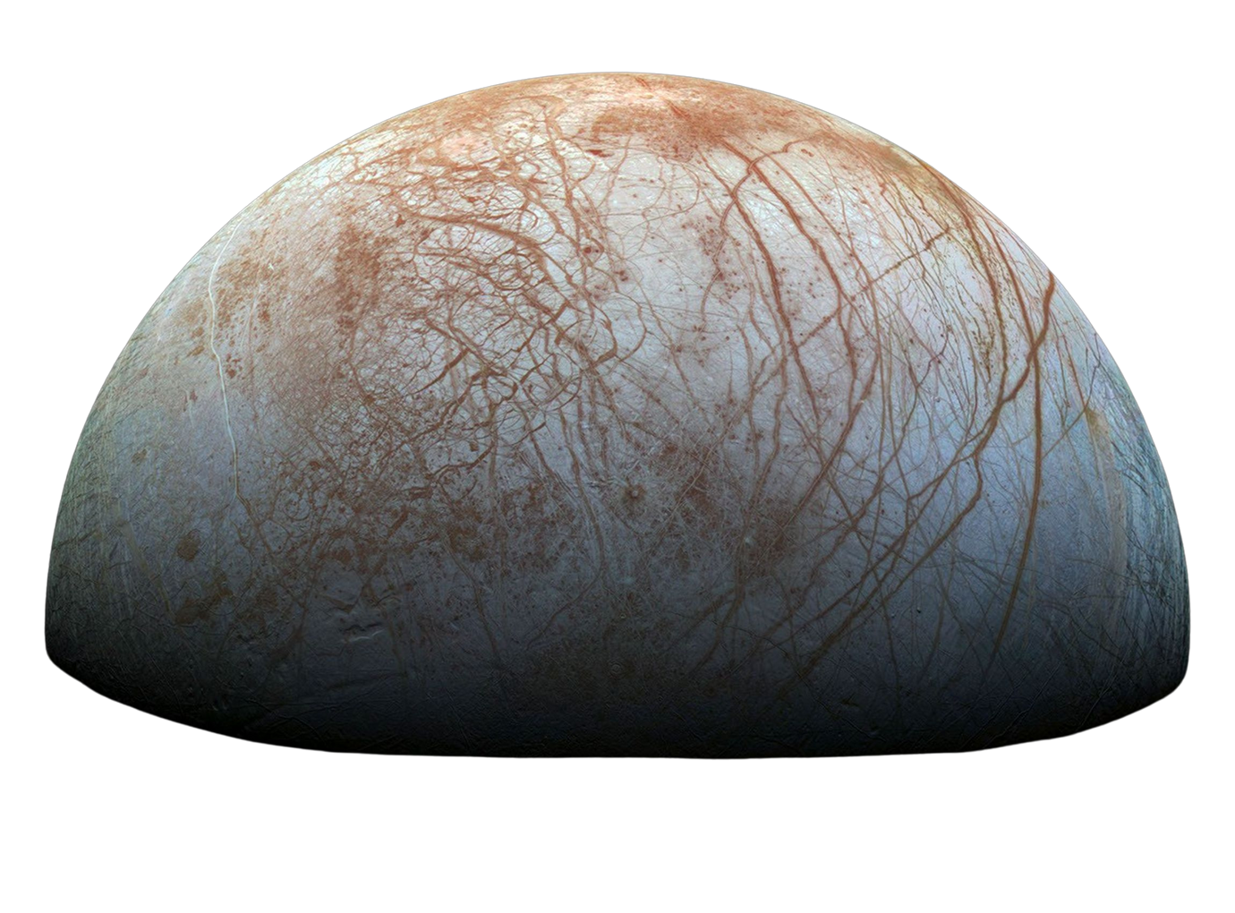
THANK YOU
THANK YOU

